Slide 1

Chapter 7
Software Engineering

Slide 2

Chapter 7: Software Engineering
7.1 The Software Engineering Discipline
7.2 The Software Life Cycle
7.3 Modularity
7.4 Design Methodologies
7.5 Tools of the Trade
7.6 Testing
7.7 Documentation
7.8 Software Ownership and Liability

Slide 3
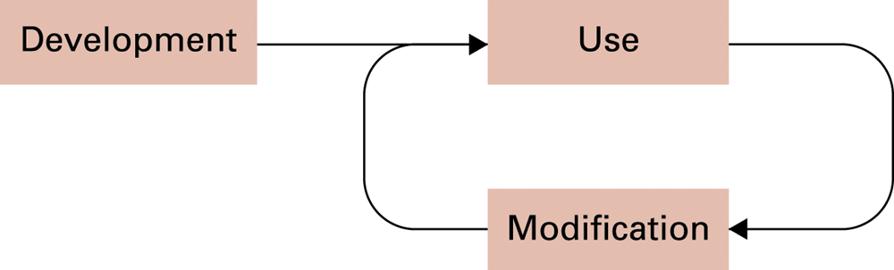
Figure 7.1 The software life cycle

Slide 4
Complications of software design
 | Traditional Engineering | Software Engineering
“Off the shelf” components available | Often | Rarely
Required performance | Within tolerances | Perfect
Quality metrics | Mean time to failure | Unclear
Scientific basis | Physics | Unclear

Slide 5
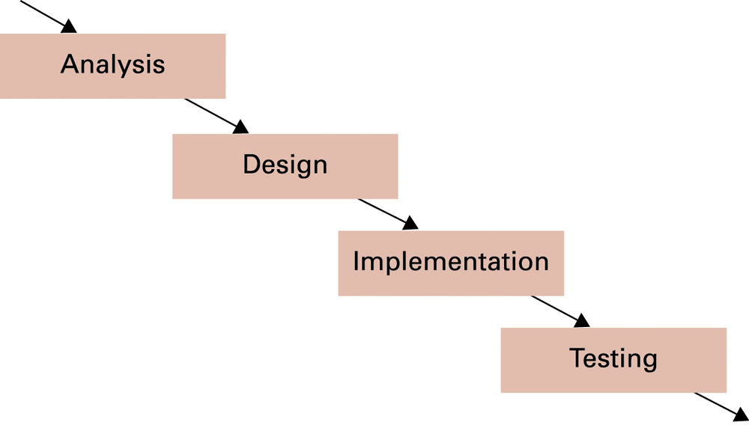
Figure 7.2 The development phase of the software life cycle

Slide 6
Advancing our ability to build high-quality software
Researchers
  Practitioners
  Theoreticians
Professional organizations: ACM, IEEE, etc.
  Codes of professional ethics
  Standards

Slide 7
Complications in modifying software
Changes often introduce more problems than they solve.
Research addressing this problem currently focuses primarily on improving initial software development.

Slide 8
Implementation Stage
Create system from design
  Write programs
  Create data files
  Develop databases

Slide 9
Testing Stage
Module testing: single module
  Often uses simplified simulators of other modules called stubs
System testing: entire program
  Extremely difficult to perform successfully
  Significant open topic of research

Slide 10
Software development models
Waterfall model
Incremental model
  Evolutionary prototyping
  Throwaway prototyping
“Extreme programming”

Slide 11
Computer Aided Software Engineering (CASE) tools
Project planning
Project management
Documentation
Prototyping and simulation
Interface design
Programming

Slide 12
Program visualization techniques
Structure chart: displays relationships between components of a procedural design
Class diagram: displays relationships between classes in an object-oriented design
  Collaboration diagram: an enhanced class diagram

Slide 13
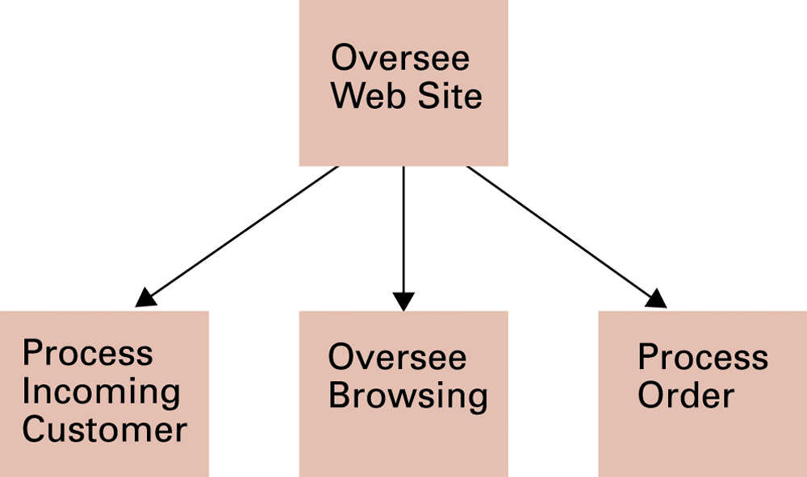
Figure 7.3 A structure chart for a simple Internet “mail order” business

Slide 14
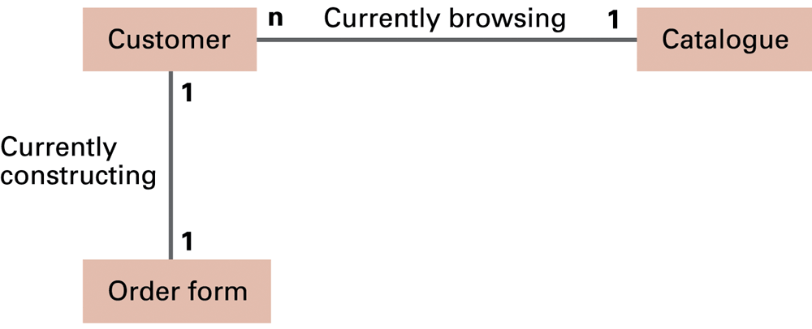
Figure 7.4 A class diagram for a simple Internet “mail order” business

Slide 15
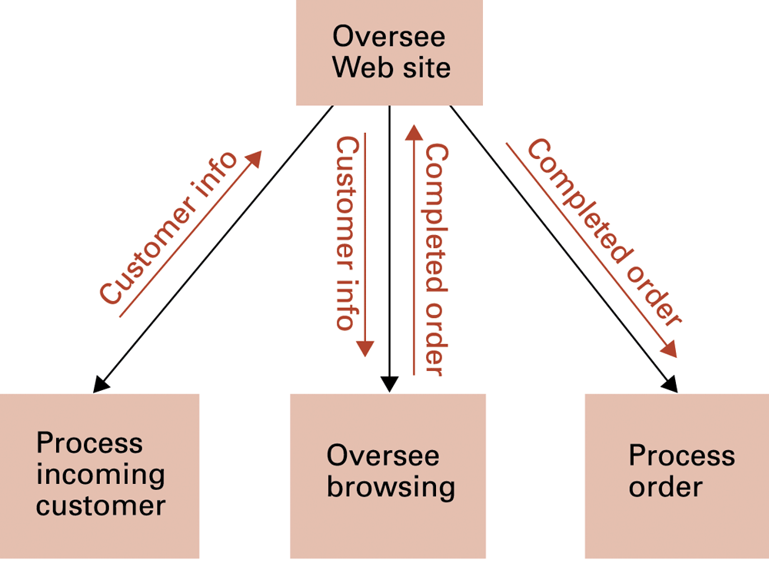
Figure 7.5 A structure chart showing data coupling

Slide 16
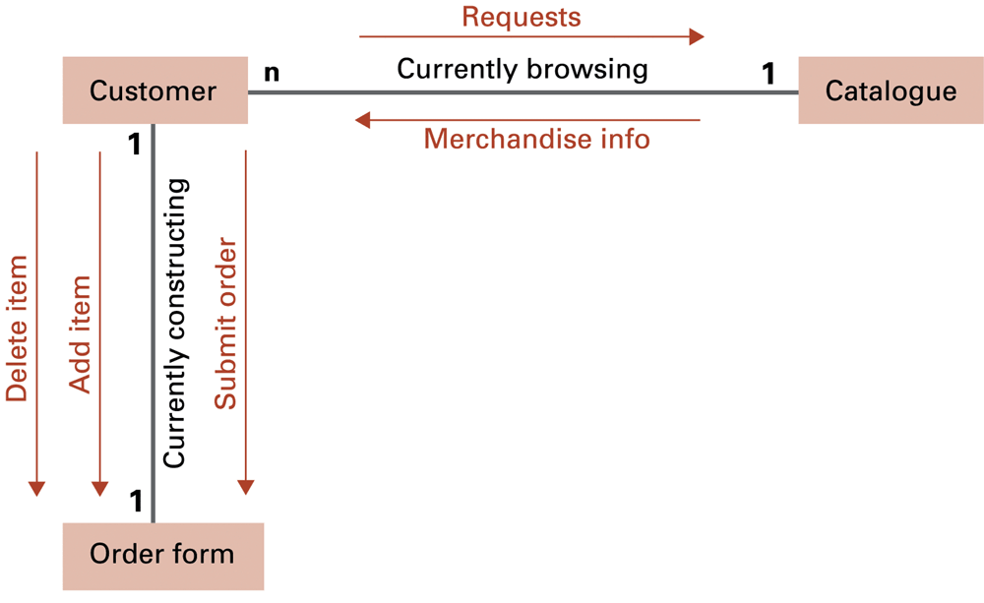
Figure 7.6 A collaboration diagram of a simple Internet “mail order” business

Slide 17
Modularity
Goal: minimize coupling and maximize cohesion
  Coupling: interactions between modules
  Cohesion: internal binding within a module

Slide 18
Coupling
Control coupling: one module passes control to another
Data coupling: sharing of data between modules
Implicit coupling: hidden coupling; frequently causes errors
  Global data = data accessible to all modules
  Side effects = action performed by a procedure that is not readily apparent to its caller

Slide 19
Cohesion
Logical cohesion: logical similarity between actions and components
Functional cohesion: components are focused around performance of a single activity
  Stronger than logical cohesion
Cohesion in object oriented systems
  Entire object will naturally be logically cohesive
  Each method should be functionally cohesive

Slide 20
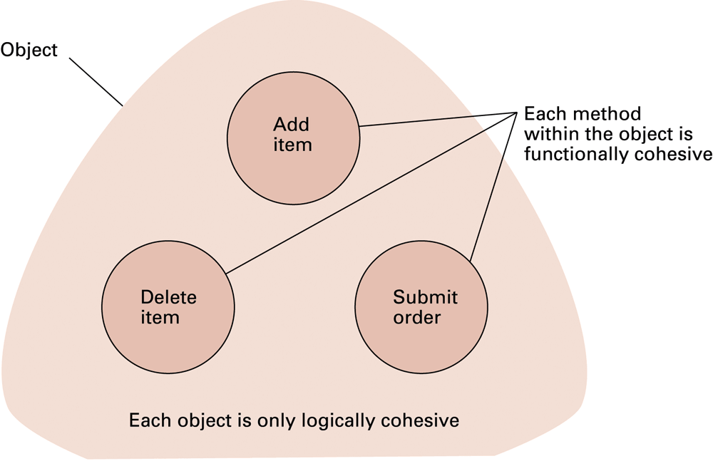
Figure 7.7 Logical and functional cohesion within an object representing an order form in a simple Internet “mail order” business

Slide 21
Other design methodologies
Top-down design
  Generates cohesive, modular designs
Bottom-up design
  Generates reusable modules

Slide 22
Other design methodologies (continued)
Design patterns
  Template libraries
    Design patterns implemented as objects
Component architecture
  Multi-object components that can be assembled into complete programs
Open-source development
  Public evolutionary prototyping

Slide 23
Data-based design techniques
Dataflow diagram: displays how data moves through a system
Entity-relationship diagram: displays relationships between entities in a system
  Relationship types
    One-to-one
    One-to-many
    Many-to-many

Slide 24
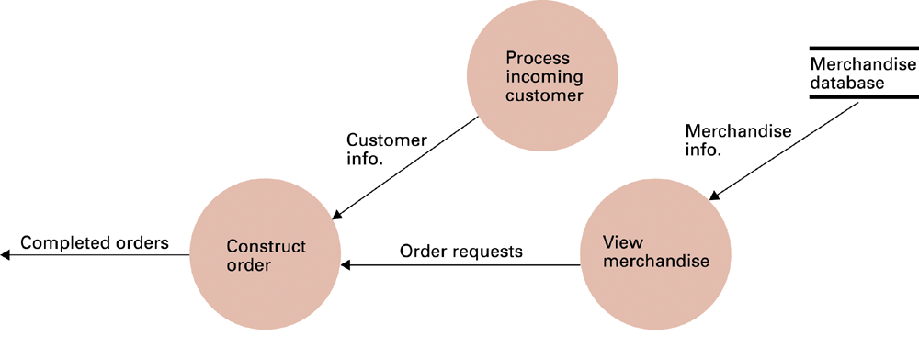
Figure 7.8 A dataflow diagram of a simple Internet “mail order” business

Slide 25
Figure 7.9 An entity-relationship diagram

Slide 26
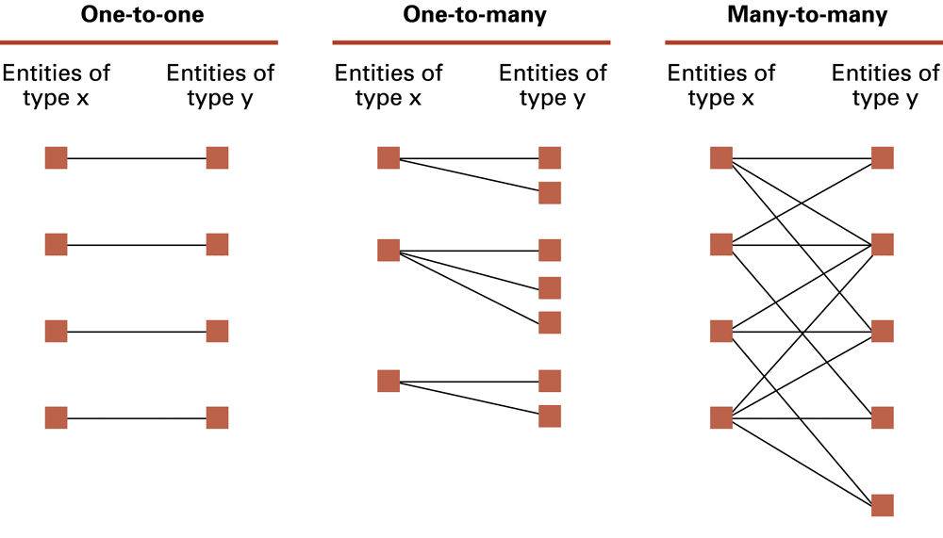
Figure 7.10 One-to-one, one-to-many, and many-to-many relationships between entities of types X and Y

Slide 27
Software testing strategies
Glass-box testing
  Pareto principle
  Basis path testing
Black-box testing
  Boundary value analysis
  Redundancy testing
  Beta testing

Slide 28
Documentation
User documentation
  Printed book for all customers
  On-line help modules
System documentation
  Source code
    Structure and naming conventions
    Comments
  Design documents
    CASE tools can help keep these up to date

Slide 29
Software ownership
Copyright
  Test = “substantial similarity”
  Filtration criteria: what is not copyrightable
    Features covered by standards
    Characteristics dictated by software purpose
    Components in the public domain
  “Look and feel” argument occasionally succeeds

Slide 30
Software ownership
Patents
  Mathematical formulae are traditionally unpatentable
  Recent exceptions for some algorithms
Trade secrets
  Non-disclosure agreements are legally enforceable

